Slide 1





Hope Line
Hope starts here, one conversation at a time
Team Members
Ibrahim Shaik
Aastha
Infosys Springboard Mental wellbeing Project

Slide 2



Features of the Project
01
Sending SOS Message
04
Inspiring Stories Blog
02
Booking Appointment
03
Daily Mood Assignment

Slide 3




USER
Make appointment
SelfAssessment
Sign up/login
View therapist
Sos Features
Technology Stack
Frontend : React ,TailwindCss
Backend : Java Spring Boot
Database : MongoDB
Frontend : React , TailwindCss
Blog
Submit appointment, self assessment , Sos , Blog
API Calls
Backend : java spring Boot
Database queries
Send notification
Database : Mongodb
Mail Service

Slide 4
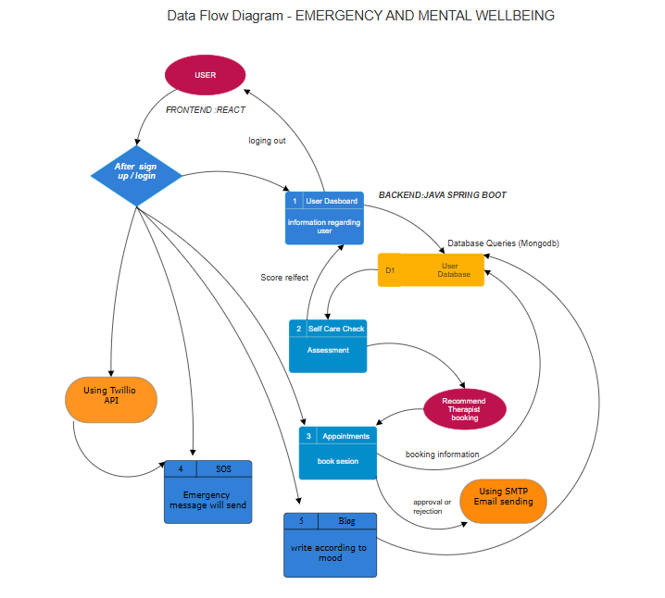

Slide 5


Modules

Slide 6

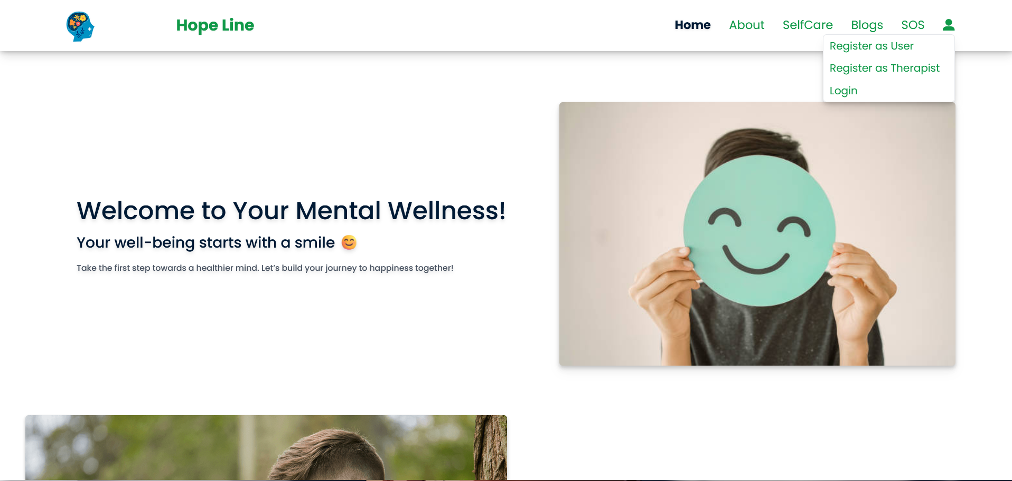


User Authentication and registration:

Slide 7


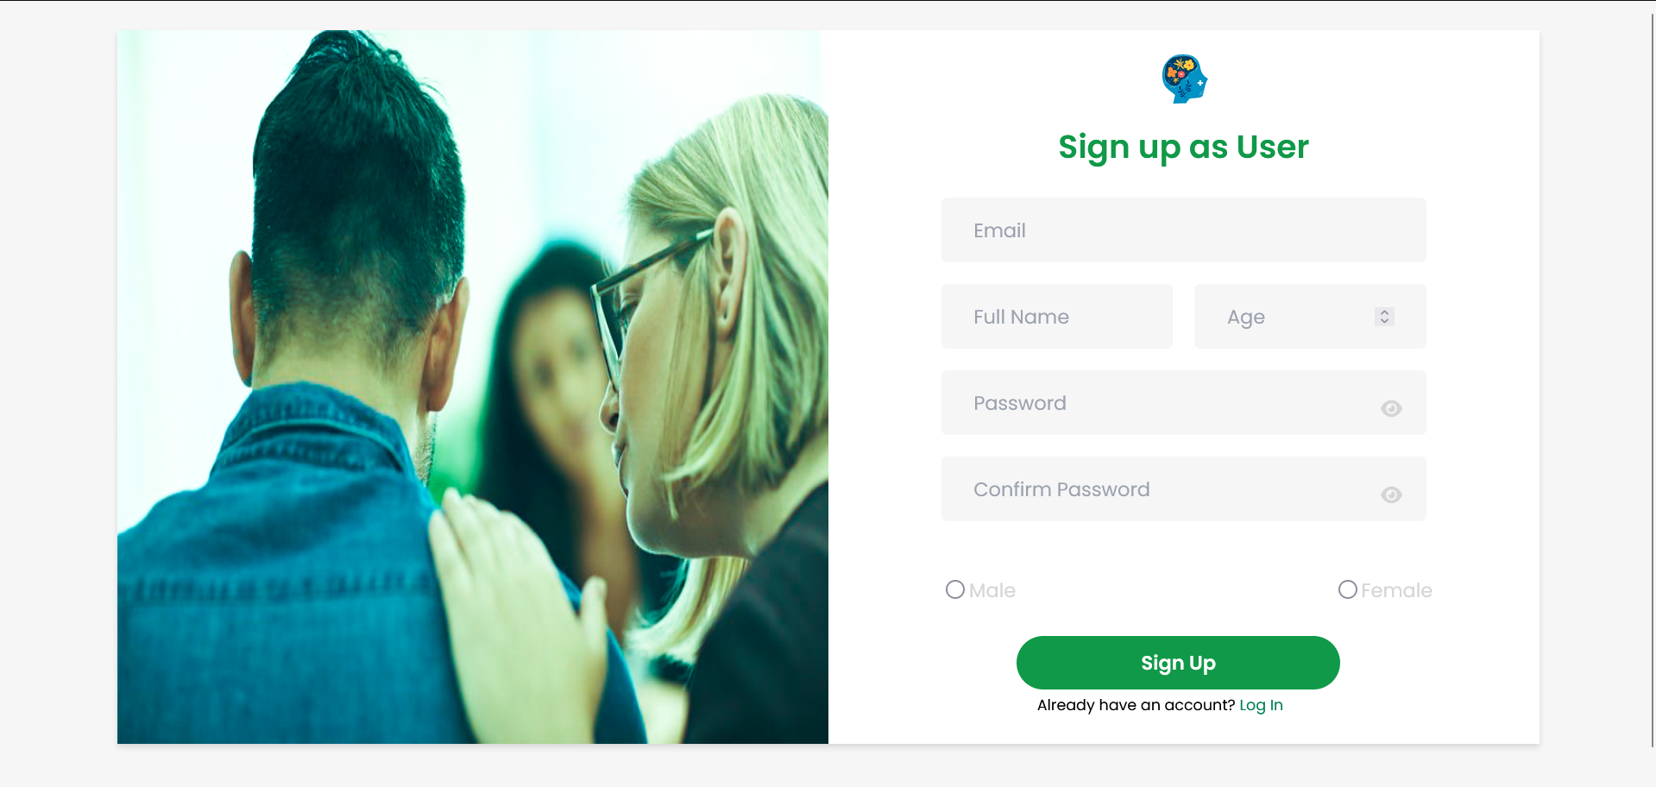
User registration Page:

Slide 8
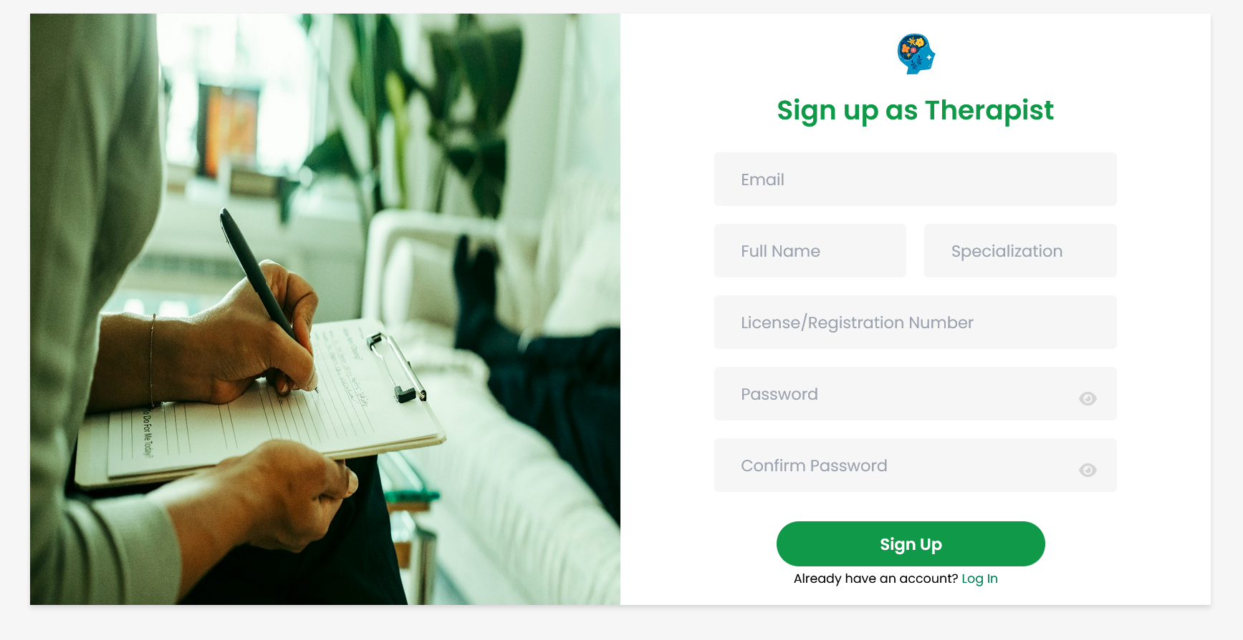
Therapist registration Page:

Slide 9
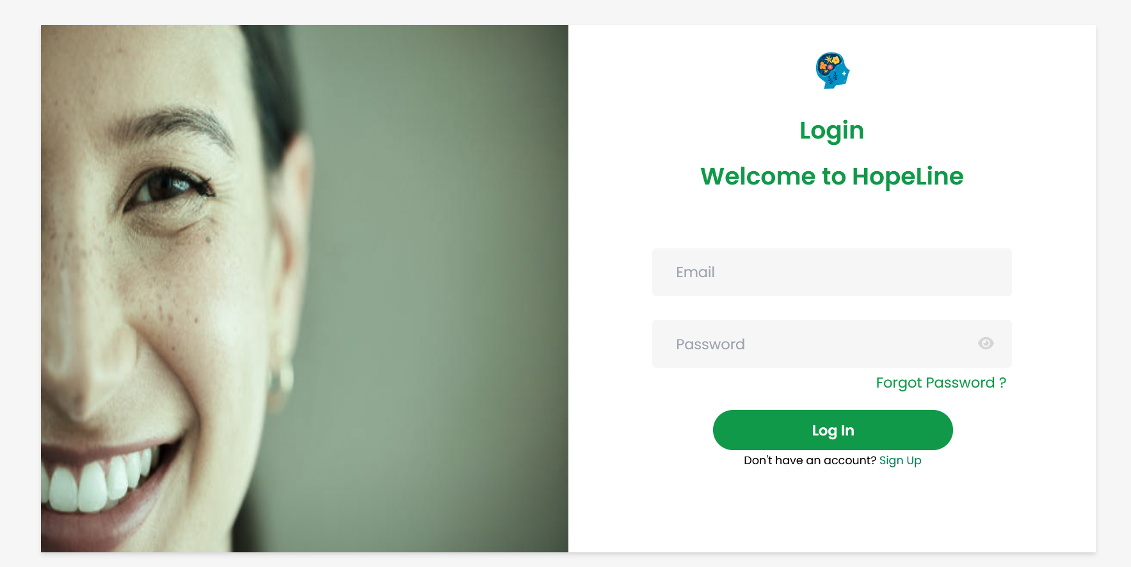
Login Page:

Slide 10

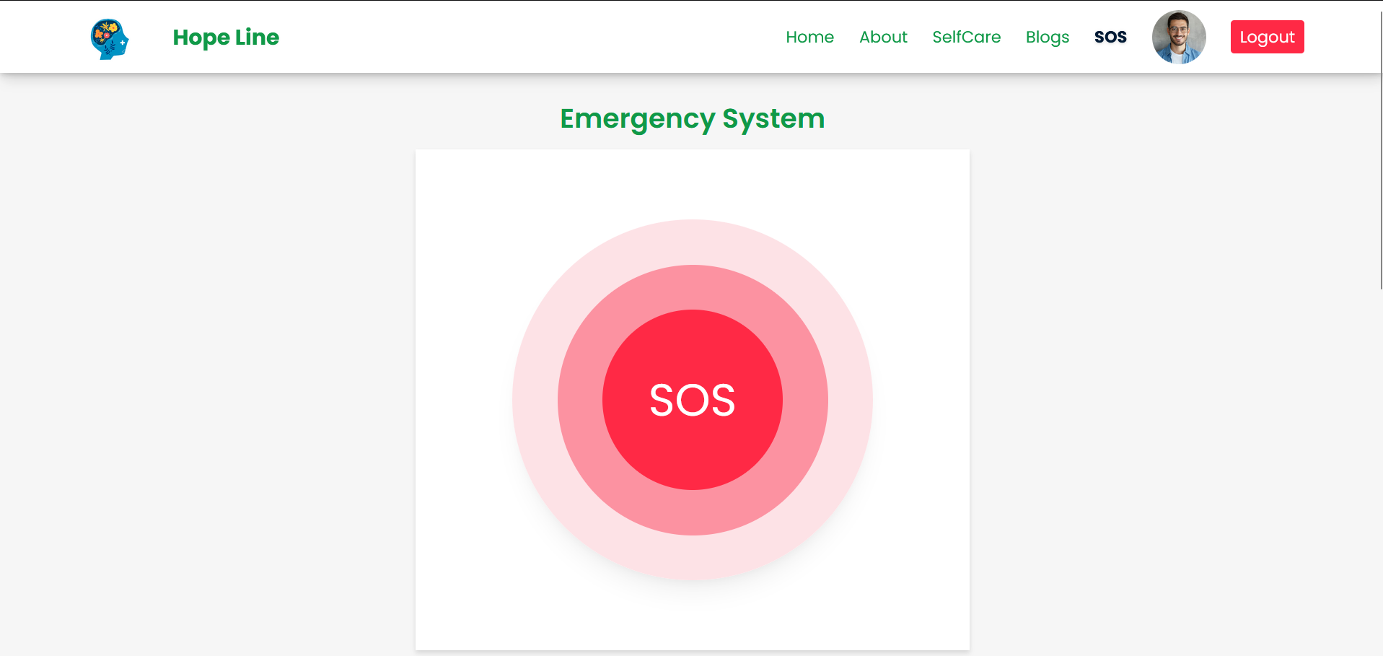

SOS button

Slide 11
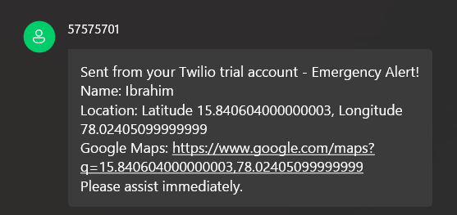
SOS Message

Slide 12
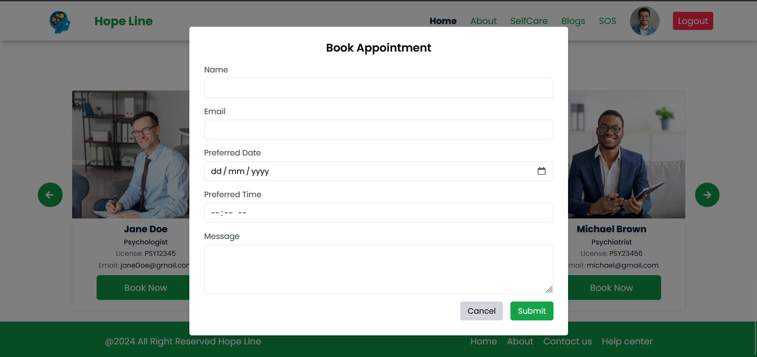
Booking Appointment

Slide 13
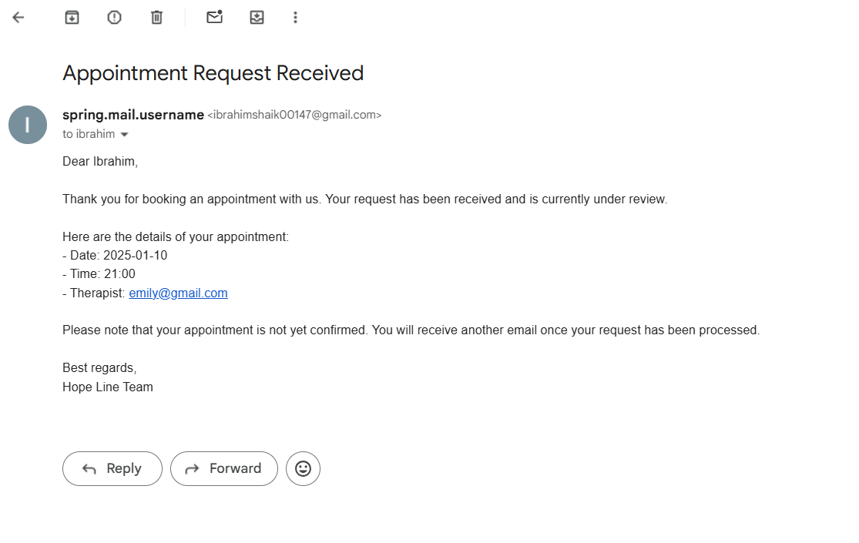

Slide 14


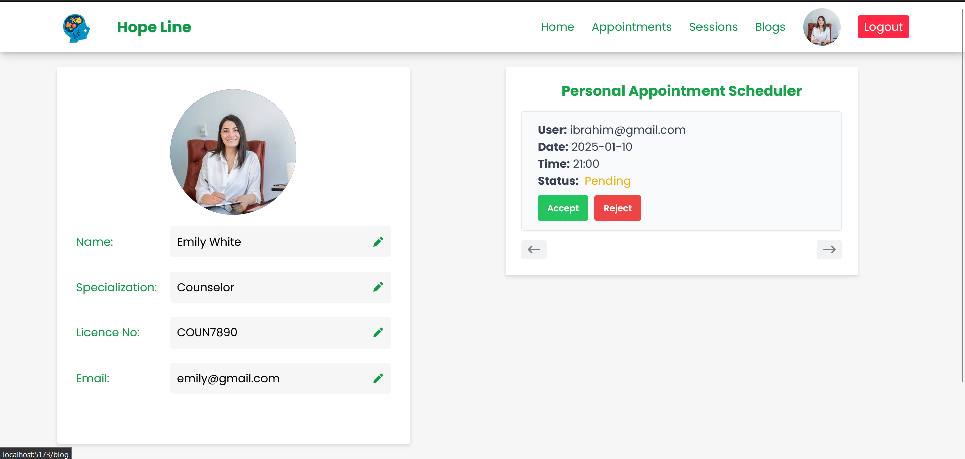


Slide 15
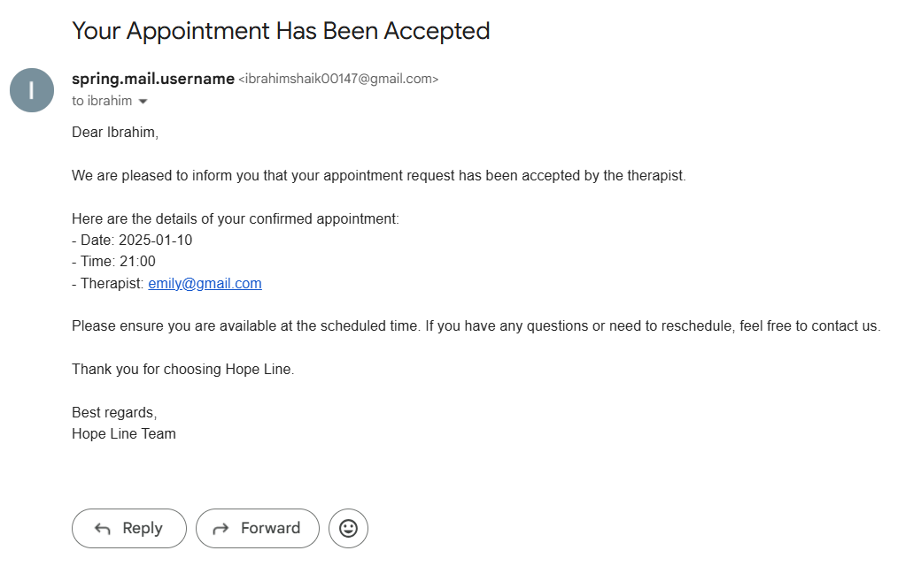

Slide 16
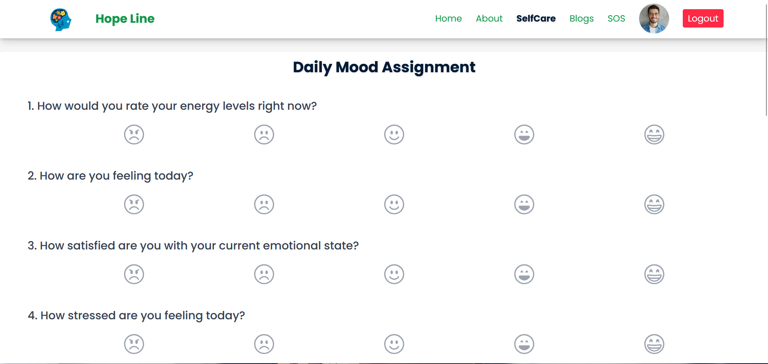
Daily Mood Assignment

Slide 17
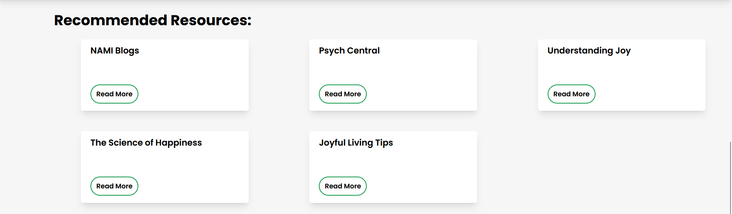

Slide 18
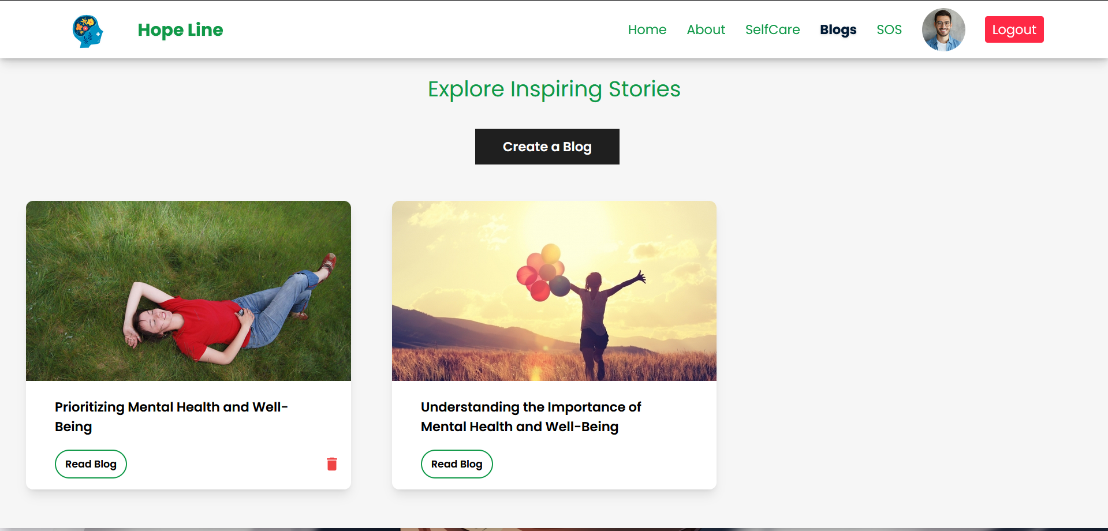
Inspiring Stories Blog

Slide 19



1. Streamlined Healthcare Access
Our Doctor Appointment System simplifies the process of booking appointments, making healthcare more accessible and efficient.
2 . Enhanced User Experience
Patients can easily register, view doctors' availability, and book appointments from the comfort of their homes.
3 . Benefits for All Stakeholders
The system benefits both patients and doctors by saving time, reducing communication gaps, and improving appointment management.
Conclusion :

Slide 20


“This project aims to bridge the gap between patients and healthcare providers using technology, ensuring a seamless and reliable experience.”

Slide 21





THANK
YOU

